Slide 1




Basic Web Design
CSS
LECTURE - 12

Slide 2
Recap
Table
Image
Link
Form

Slide 3
Course Contents
Display
Position
Overflow
Github

Slide 4
CSS Display
The display property is the most important CSS property for controlling layout.
The display property is used to specify how an element is shown on a web page.
Every HTML element has a default display value, depending on what type of element it is. The default display value for most elements is block or inline.
The display property is used to change the default display behavior of HTML elements.
The display property has various values that influence how elements behave in terms of size, position, and layout.

Slide 5
Inline Elements
An inline element does not start on a new line and only takes up as much width as necessary.
<span>
<a>
<img>
<input>
<label>
<button>
<select>
<textarea>

Slide 6
Block Elements
A block-level element ALWAYS starts on a new line and takes up the full width available
<div>
<h1> - <h6>
<p>
<form>
<header>
<footer>
<section>
<article>
<nav>
<ul>, <ol>, <li>
<table>, <tr>, <thead>, <tbody>

Slide 7
Display Property
Inline
Block
Inline-block: This combines features of both inline and block. It allows an element to be laid out inline (next to other elements), but the element behaves like a block in terms of width and height (you can set its width and height explicitly).
button {
display: inline-block;
width: 150px;
height: 40px;
}

Slide 8
Display Property
Inline
Block
Inline-block: This combines features of both inline and block. It allows an element to be laid out inline (next to other elements), but the element behaves like a block in terms of width and height (you can set its width and height explicitly).
button {
display: inline-block;
width: 150px;
height: 40px;
}

Slide 9
Display Property
none: An element with display: none; will be completely removed from the layout and won't occupy any space on the page. This is useful for hiding elements.
flex: display:flex; turns an element into a flex container, enabling flexbox layout. Its child elements (flex items) can then be laid out along a main axis and cross axis with properties like justify-content, align-items, and flex-direction.
/* Flexbox Layout */
.flex-container {
display: flex;
justify-content: space-between;
background-color: lightgray;
padding: 10px;
}

Slide 10
Position
The position property specifies the type of positioning method used for an element.
There are five different position values:
static
relative
fixed
absolute
sticky
Elements are then positioned using the top, bottom, left, and right properties.
However, these properties will not work unless the position property is set first.

Slide 11
Position
Static: Default position
Relative:
The element is positioned relative to its normal position in the document flow.
This means you can move it from its original position using the top, right, bottom, and left properties.
.relative-element {
position: relative;
top: 10px;
left: 20px;
}

Slide 12
Position
Fixed: An element with position: fixed; is positioned relative to the viewport, which means it always stays in the same place even if the page is scrolled. The top, right, bottom, and left properties are used to position the element.
div.fixed { position: fixed; bottom: 0; right: 0; width: 300px; border: 3px solid #73AD21; }
Absolute:
sticky

Slide 13
Position
Absolute: An element with position: absolute; is positioned relative to the nearest positioned ancestor (instead of positioned relative to the viewport, like fixed).
div.fixed { position: fixed; bottom: 0; right: 0; width: 300px; border: 3px solid #73AD21; }
Absolute:
sticky

Slide 14
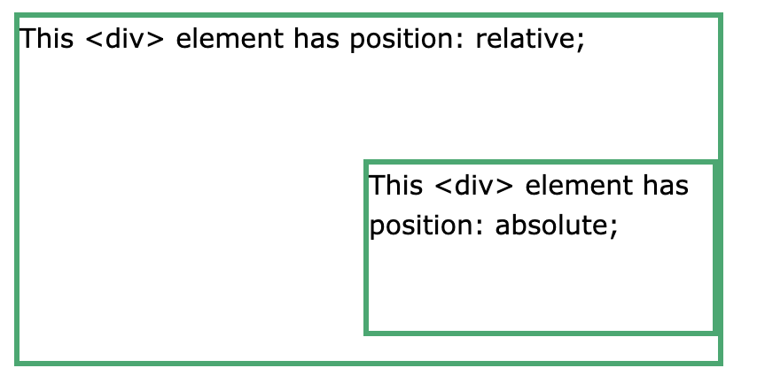
Position
Absolute: An element with position: absolute; is positioned relative to the nearest positioned ancestor (instead of positioned relative to the viewport, like fixed).
div.absolute { position: absolute; top: 80px; right: 0; width: 200px; height: 100px; border: 3px solid #73AD21; }

Slide 15
Position
Sticky: An element with position: sticky; is positioned based on the user's scroll position.
div.sticky { position: sticky; top: 0; background-color: green; border: 2px solid #4CAF50; }

Slide 16
Overflow
The overflow property specifies whether to clip the content or to add scrollbars when the content of an element is too big to fit in the specified area.
The overflow property has the following values:
visible - Default. The overflow is not clipped. The content renders outside the element's box
hidden - The overflow is clipped, and the rest of the content will be invisible
scroll - The overflow is clipped, and a scrollbar is added to see the rest of the content
auto - Similar to scroll, but it adds scrollbars only when necessary

Slide 17
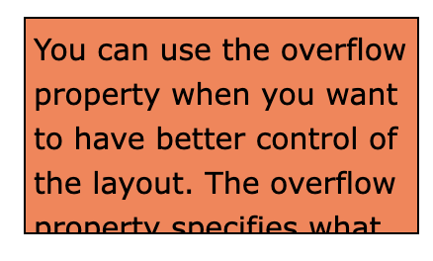
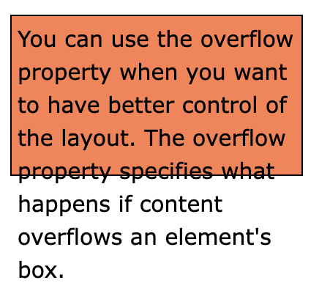
Overflow
Overflow:visible;
Overflow:hidden;
Overflow:scroll;
Auto:scroll;

Slide 18
Overflow
Overflow:visible;
Overflow:hidden;
Overflow:scroll;
Auto:scroll;

Slide 19
Class Work
Design your complete CV
Upload this as an Assignment in your github account. [Assignment]

Slide 20

End of Lecture​

